Slide 1
Arduino → INPUTS
CCLab 2016 – Week 5

Slide 2
What is an INPUT?
An input device is a peripheral, component, or hardware equipment used to provide data and control signals to an information processing system such as a computer or information appliance.

Slide 3
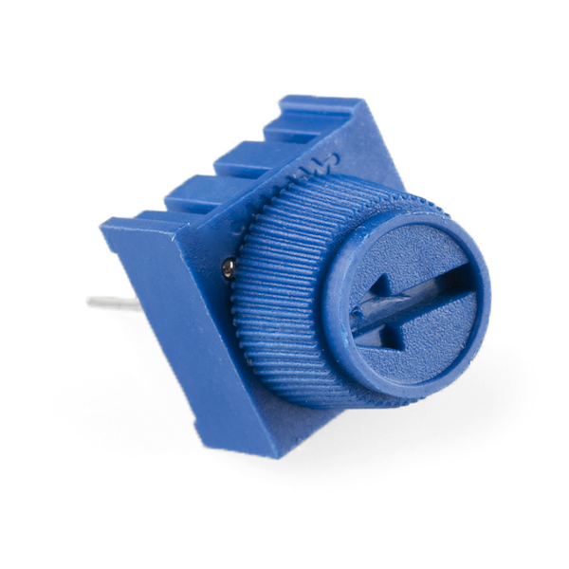
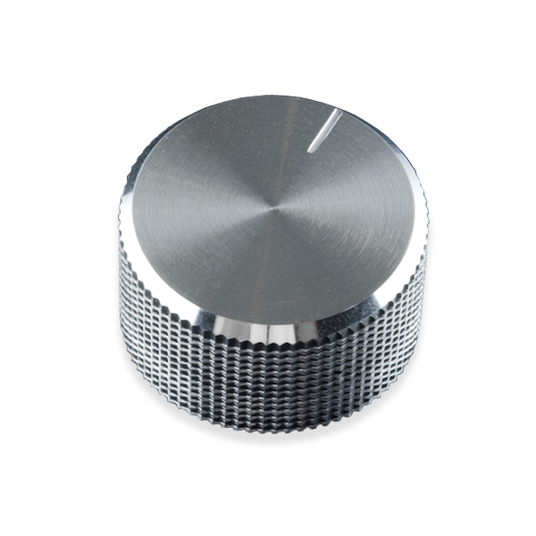
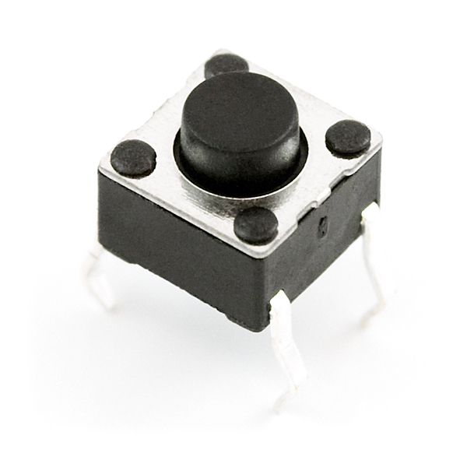
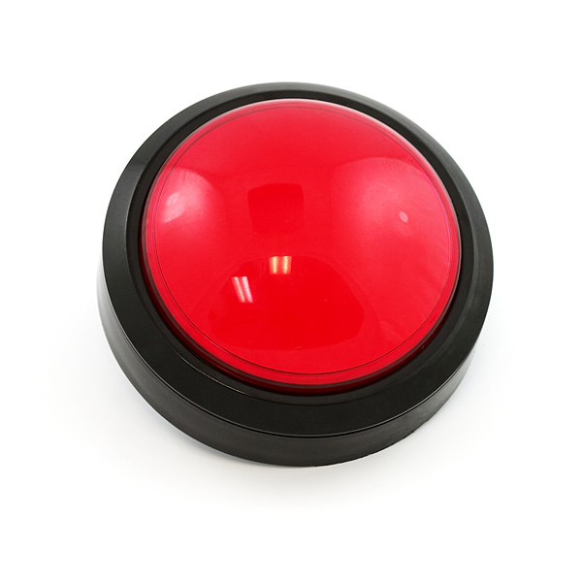
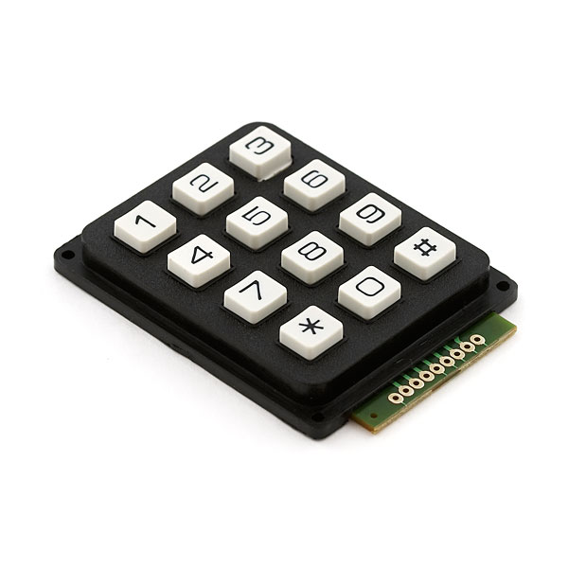
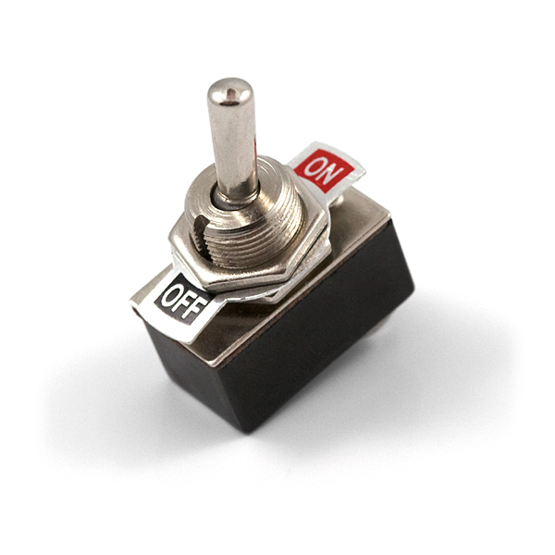
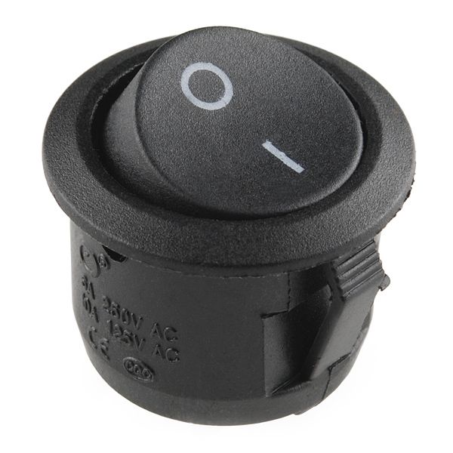
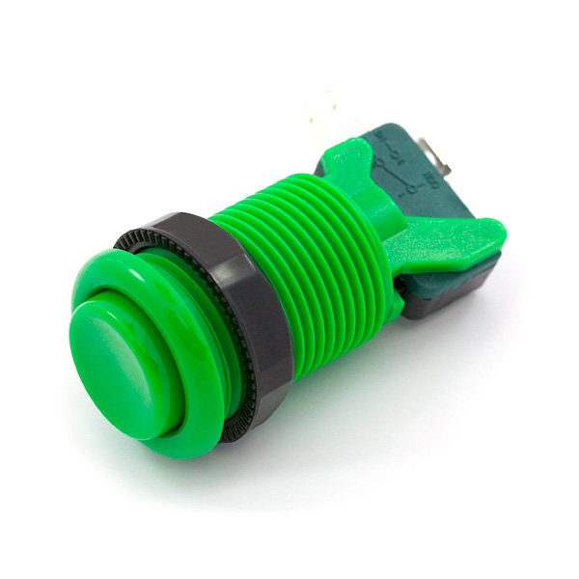
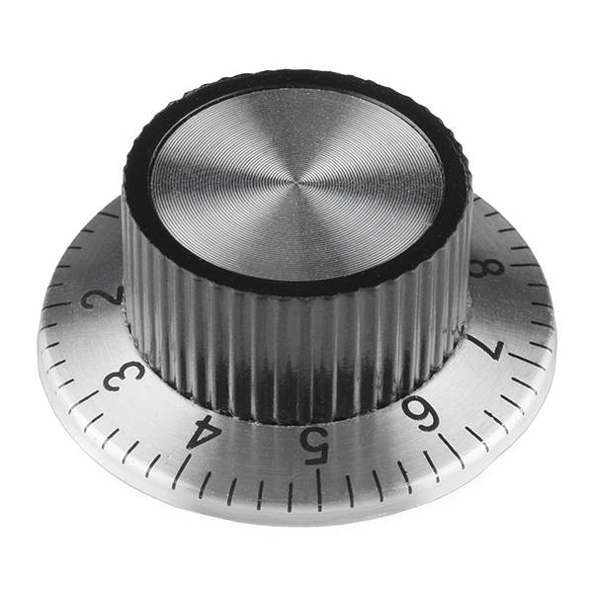
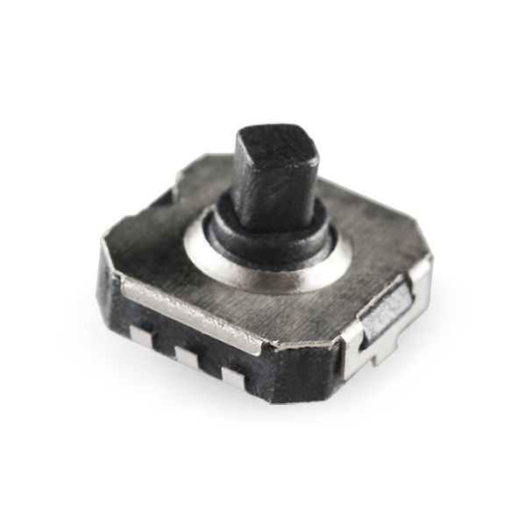
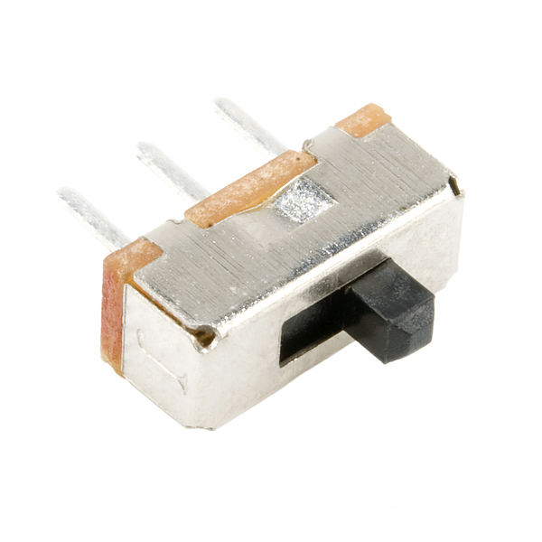
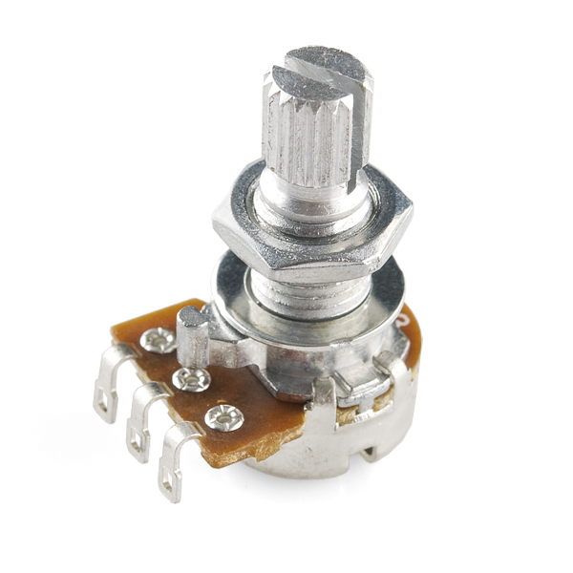
Examples
Potentiometer
Knob
Button
Big Button
Keypad
Switch
Switch
Arcade Button
5 way switch
Knob
Switch
Potentiometer
Notes:
There are many types of inputs that you can use with your arduino… the expected kind like buttons and switches

Slide 4
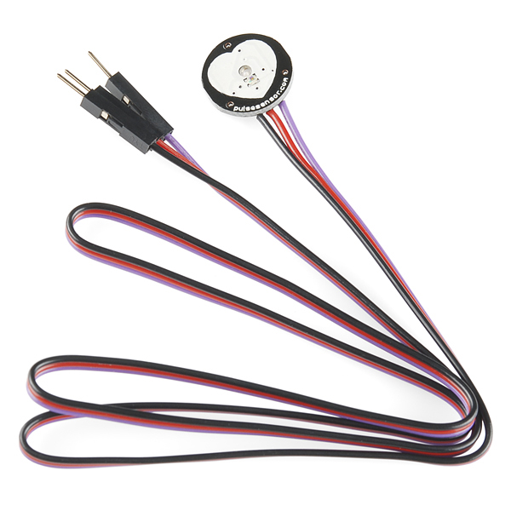
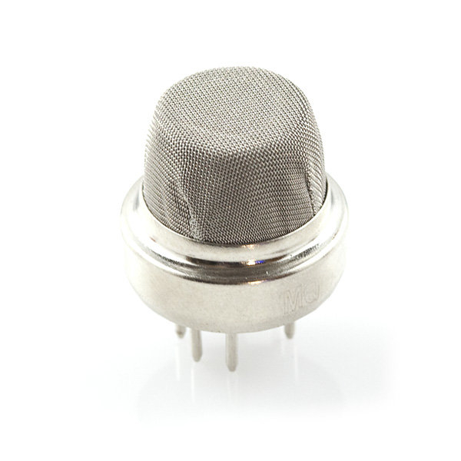
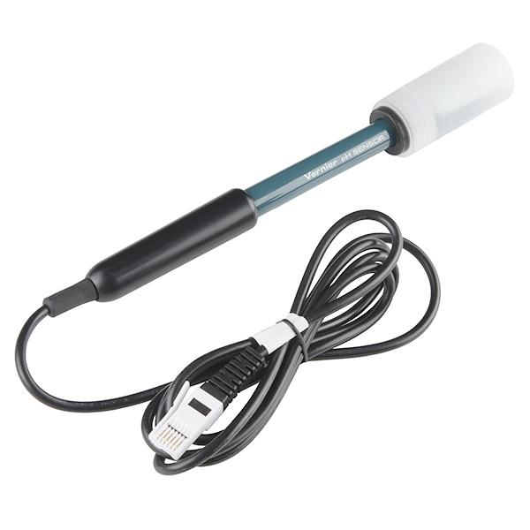
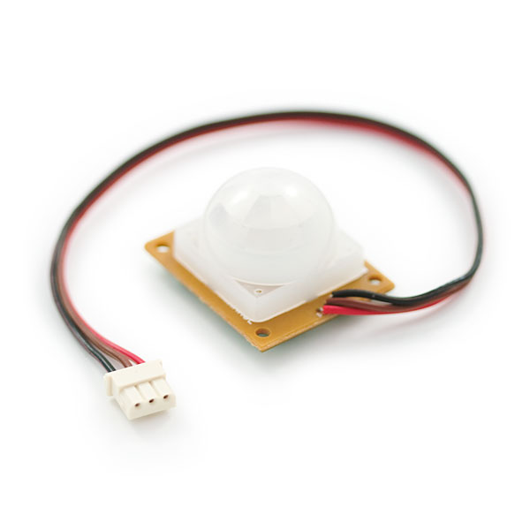
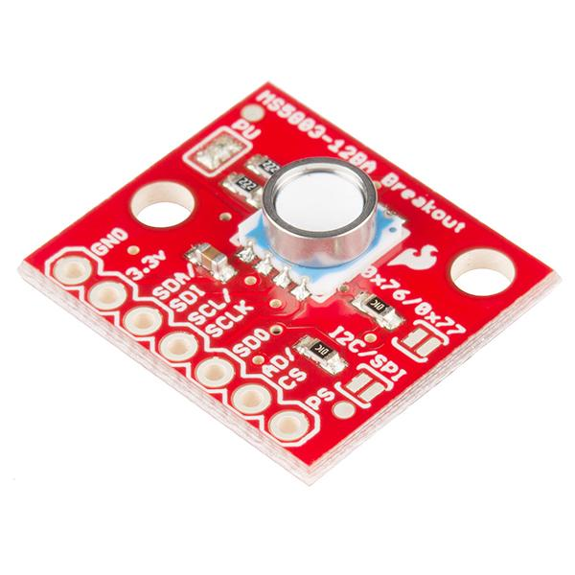
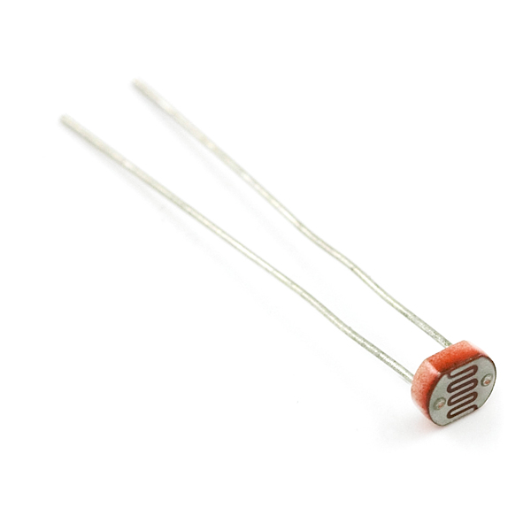
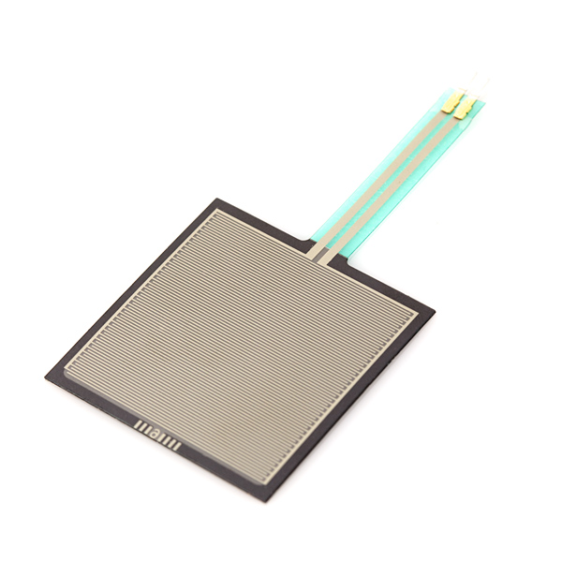
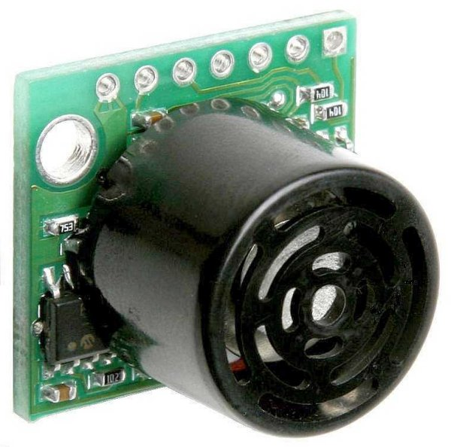
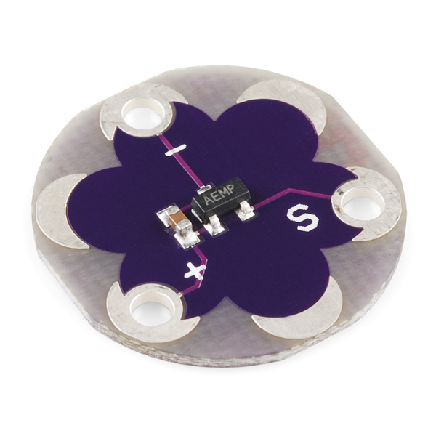
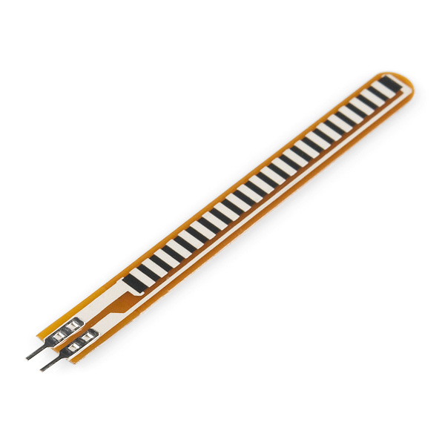
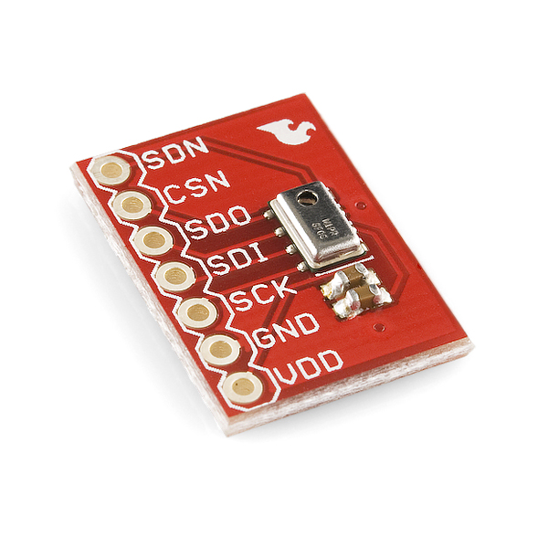
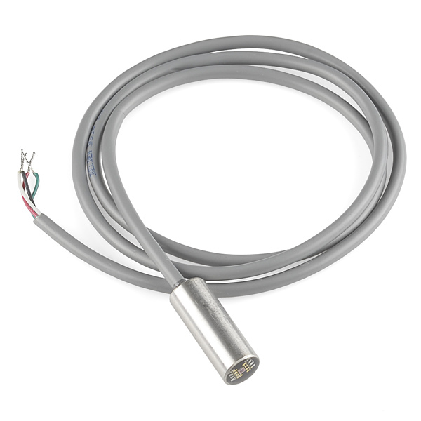
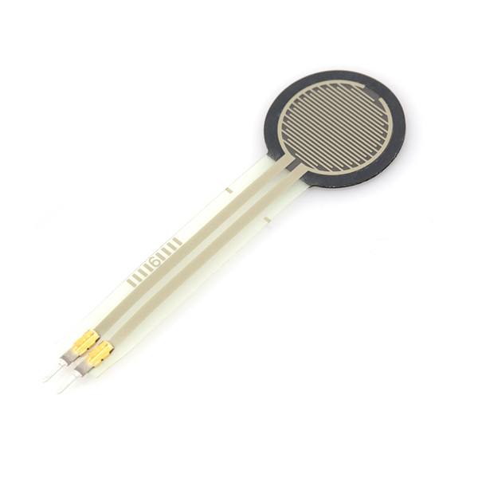
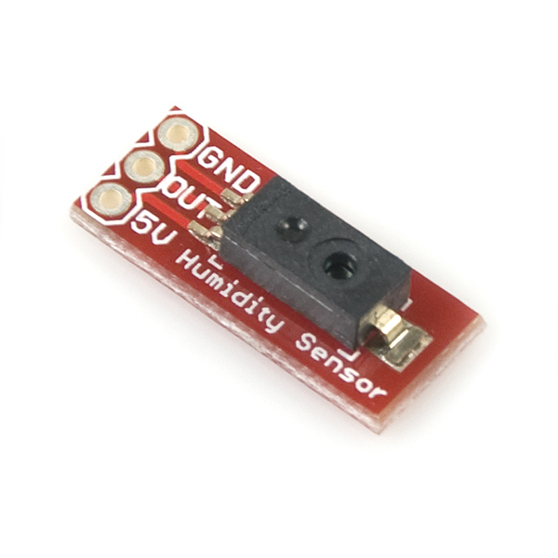
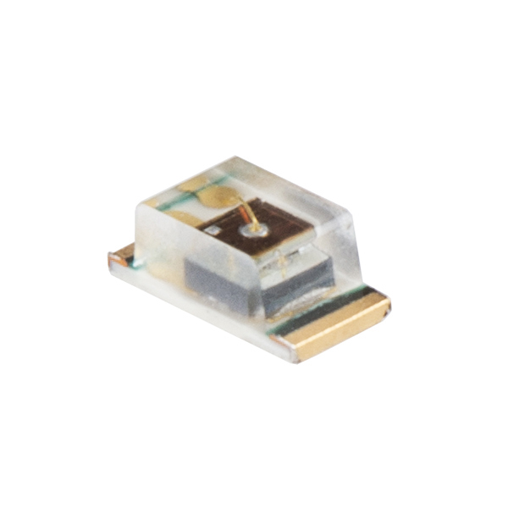
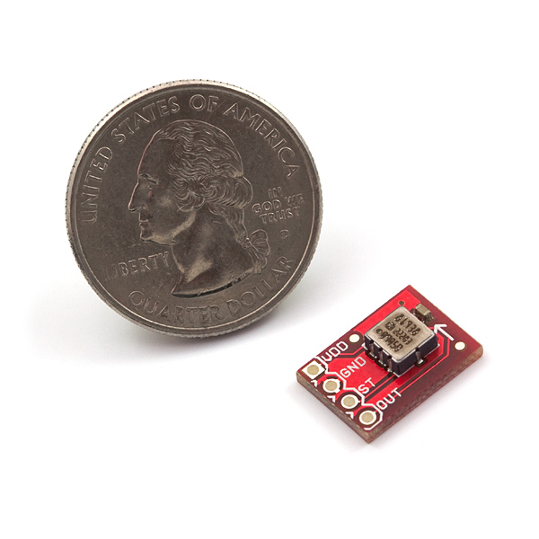
Gas
Motion
Pulse
Pressure
pH
Range Finder
Photocell
Temperature
Force
Barometric Pressure
Flex
Humidity
Single Axis Accelerometer
Color
Light
Force
Notes:
and ones that measure other things. Some of these are really amazing

Slide 5
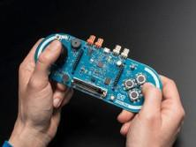
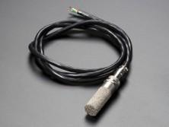

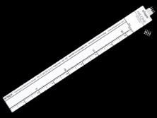
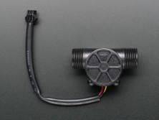
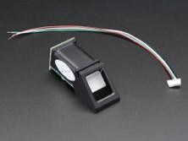
INPUTS
GAME CONTROLLERS
SOIL TEMP / MOISTURE
TOUCHSCREEN
LIQUID LEVELS
LIQUID FLOW METERS
FINGERPRINT
Notes:
More Input examples!

Slide 6
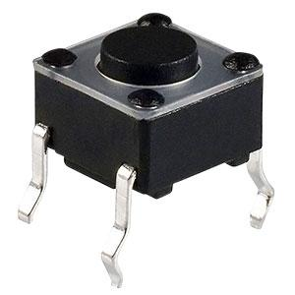
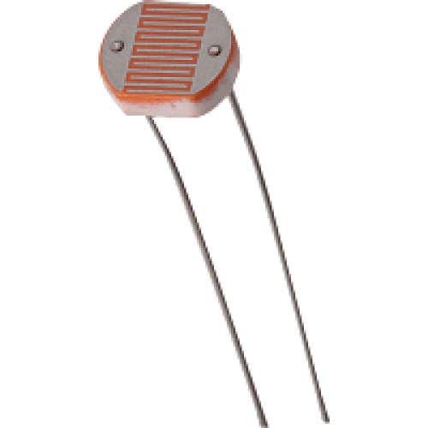
Digital – Switch
Analog-LDR

Slide 7
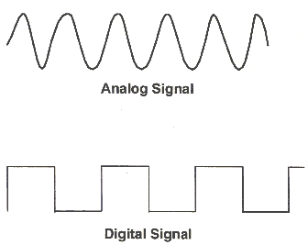
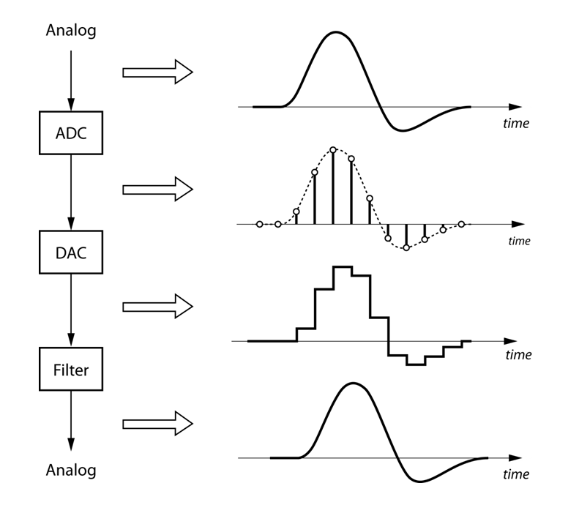
Analog vs. Digital Input

Slide 8
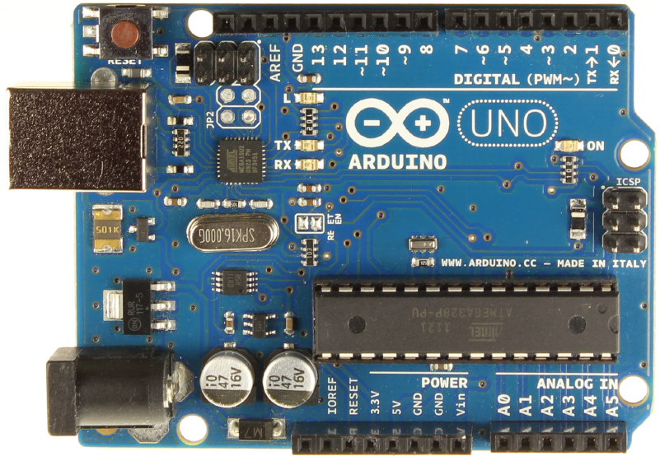
Digital Pins
Notes:
This is important as we learned last week because we have analog and digital pins.
Digital pins can act as inputs or outputs. They read digital inputs

Slide 9
Analog Pins
Notes:
And analog pins can read analog inputs

Slide 10
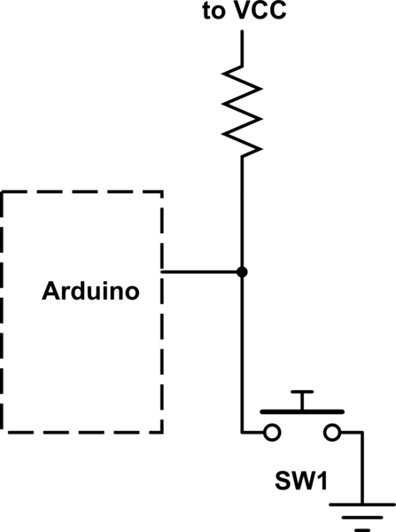
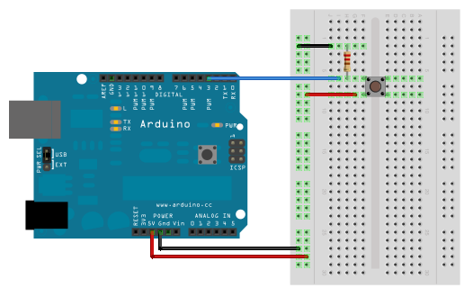
Digital Input - Hookup

Slide 11
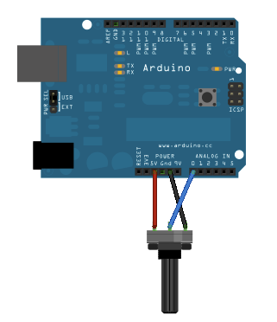
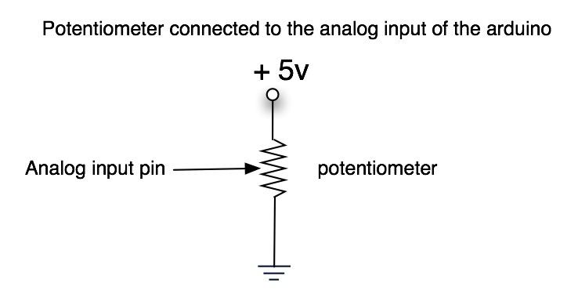
Analog Input - Hookup

Slide 12
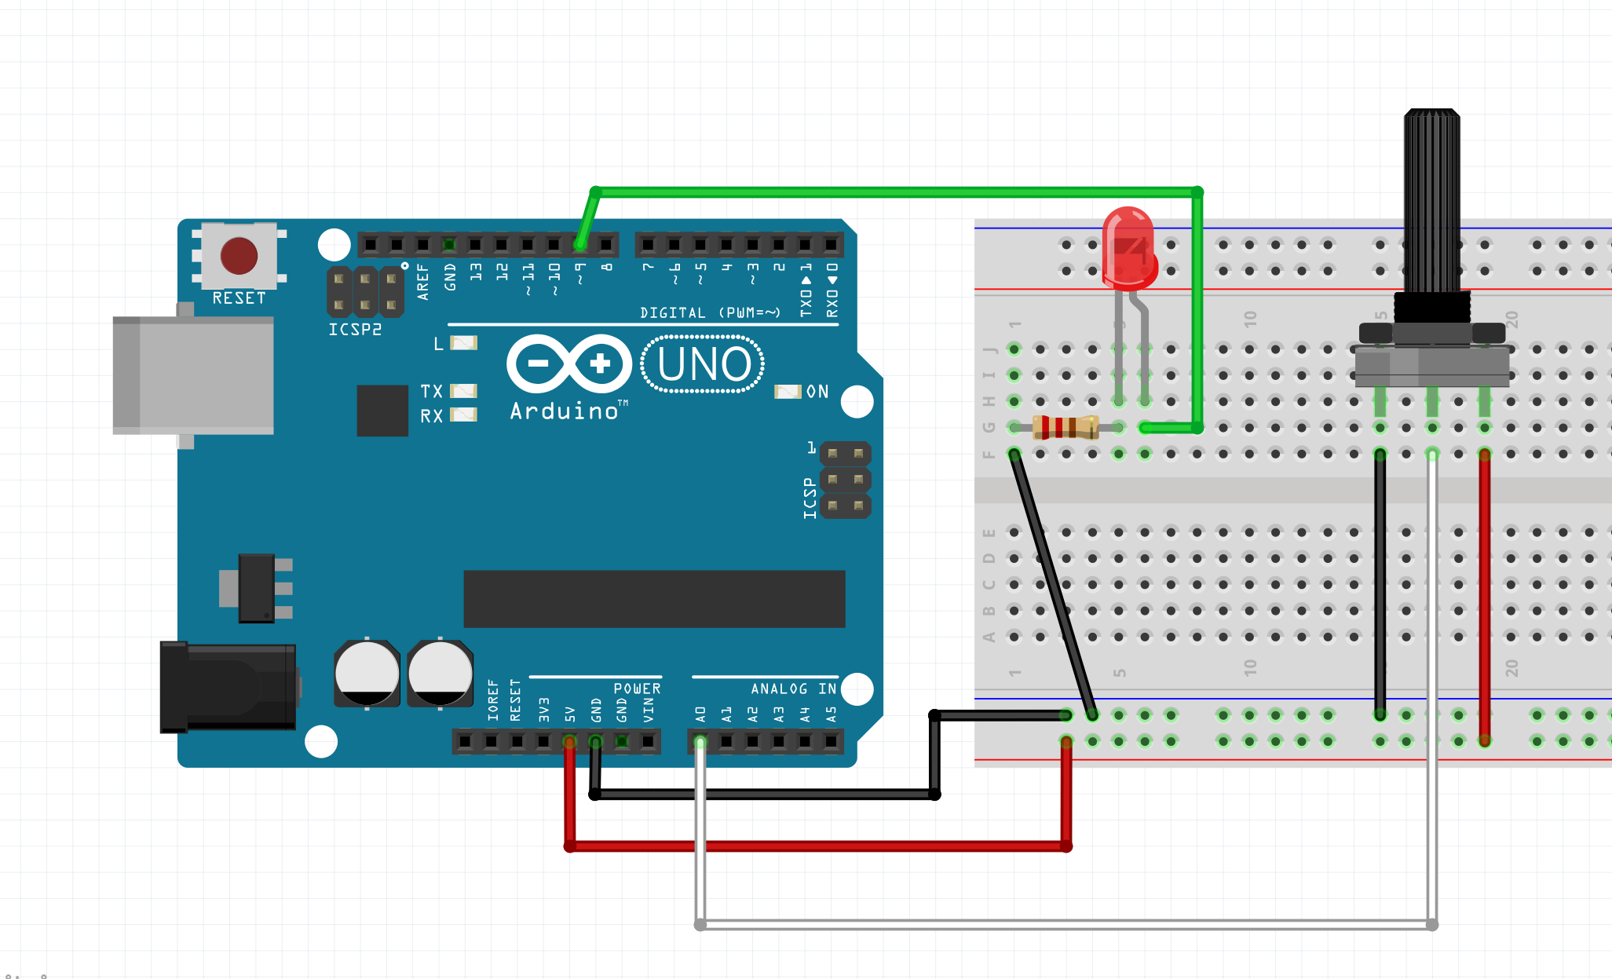
Control an LED with a Sensor
Notes:
Today we are going to control the brightness of an LED with various inputs

Slide 13
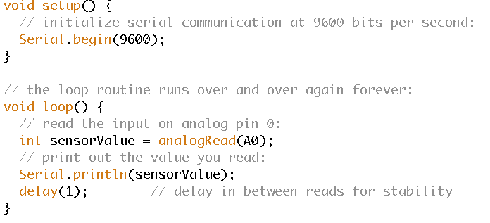
File > Examples > Basic > AnalogReadSerial
Notes:
We are going to start with the example file AnalogReadSerial so that we can see what kind of values we are getting from our input

Slide 14
File > Examples > Basic > AnalogReadSerial
Notes:
Lets look at the code:
We need to tell the computer that we will be listening over the serial port.

Slide 15
File > Examples > Basic > AnalogReadSerial
Notes:
We make a variable to hold the data coming in from pin A0

Slide 16
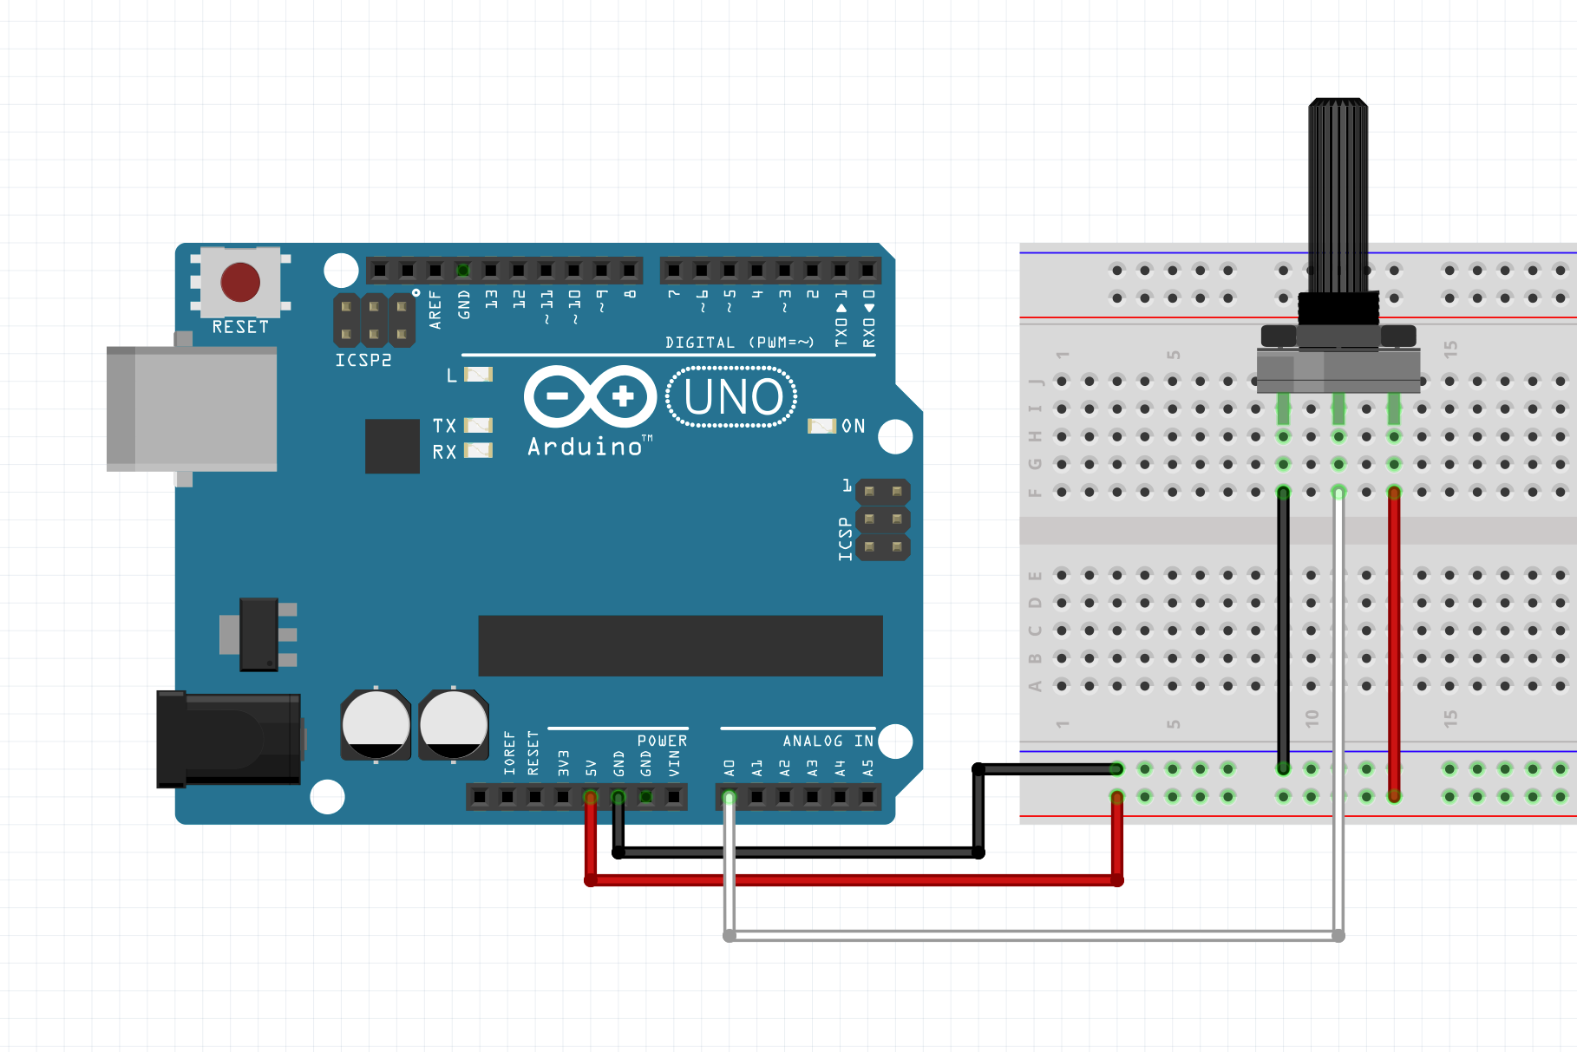
Connecting the Input
Notes:
Connect the middle pin to A0 and the outer pins to ground and power
Upload your sketch

Slide 17
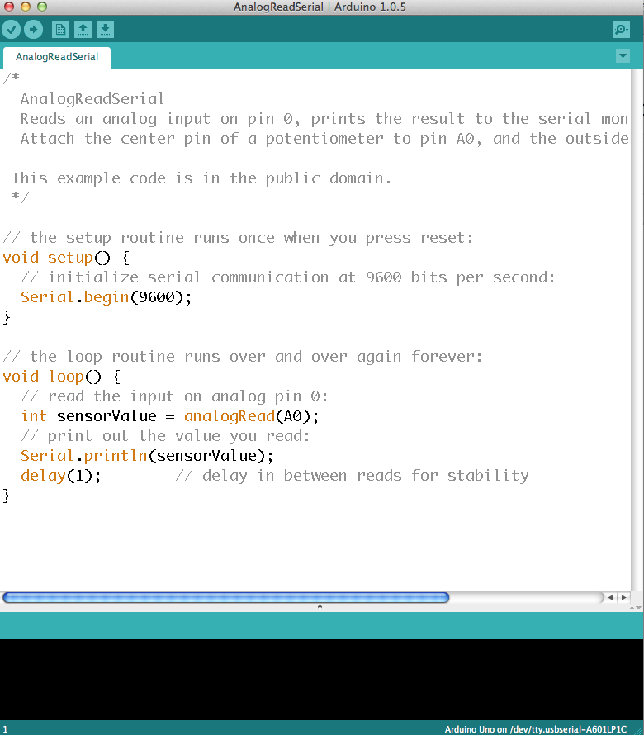
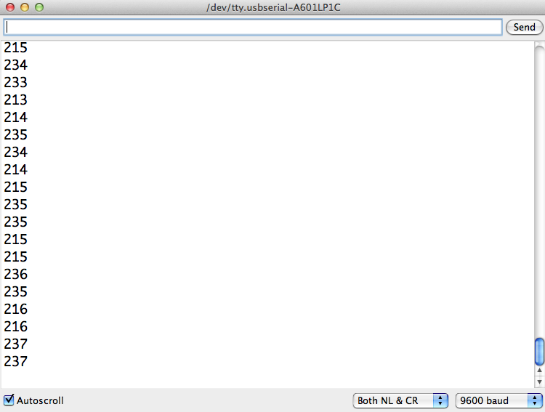
Serial Monitor
Notes:
Open your Serial Monitor
Your baud rate must match the one in your serial monitor
Now as we turn the knob on the potentiometer we can see the value coming back to the computer
It is between 0 and 1024

Slide 18
Analog Output
Notes:
Now we want to see this output in a visual way, so we are going to connect an LED and have its brightness dictated by the input.
This is not HIGH or LOW it is somewhere in between -- Analog
Analog Output is only possible on some pins. Look for the pins with the wavy ~ symbol. We are using pin 9 so that we can write values between 0 and 255 to our output pin rather than just writing HIGH and LOW

Slide 19
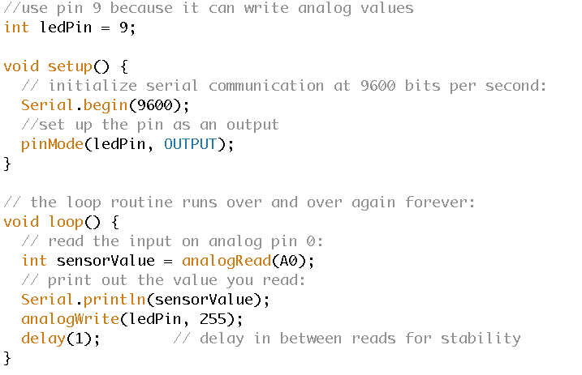
Adding to the Code
Notes:
We will add an LED to the code. Set up the LED pin as pin 6, make it an output pin, use the analogWrite function to send the highest value possible to this LED (255)
Next, in the main loop of the code, sensorValue is assigned to store the raw analog value coming in from the potentiometer. Because the Arduino has an analogRead resolution of 0-1023, and an analogWrite resolution of only 0-255, this raw data from the potentiometer needs to be scaled before using it to dim the LED.
In order to scale this value, use a function called map()
outputValue = map(sensorValue, 0, 1023, 0, 255);

Slide 20
Connecting the LED

Slide 21
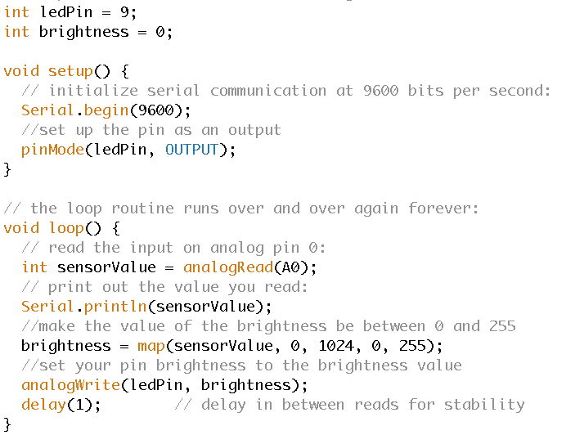
Adding to the Code
Notes:
We want the LED brightness to be affected by the sensor value, so we make a new variable called brightness and use the map function to take the sensorValue (which was previously between 0 and 1024) and set brightness equal to the new value between 0 and 255
Now when we rotate our potentiometer we can see the brightness change.

Slide 22


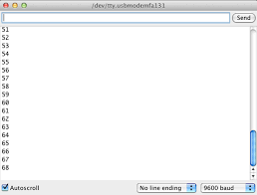
PWM out - PWM in
PWM
Serial
Notes:
http://www.benripley.com/diy/arduino/three-ways-to-read-a-pwm-signal-with-arduino/

Slide 23
PWM - pulseIn()
The pulseIn() waits for the pin to go HIGH, starts timing, then waits for the pin to go LOW and stops timing. Returns the length of the pulse in microseconds.
byte PWM_PIN = 3;
int pwm_value;
void setup() {
pinMode(PWM_PIN, INPUT);
Serial.begin(115200);
}
void loop() {
pwm_value = pulseIn(PWM_PIN, HIGH);
Serial.println(pwm_value);
}
void setup() {
pinMode(3,OUTPUT);
}
void loop() {
analogWrite(3,1000);
delay (3000);
analogWrite(3,2000);
delay (3000);
analogWrite(3,3000);
delay (3000);
analogWrite(3,4000);
delay (3000);
}
Notes:
processor can’t be used

Slide 24
PWM Interrupt
Most Arduino boards have two external interrupts: numbers 0 (on digital pin 2) and 1 (on digital pin 3). These interrupts can be set to trigger on RISING or FALLING signal edges, or on low level. Once attached, when an interrupt is triggered, the specified interrupt service routine (ISR) will be called.
volatile int pwm_value = 0;
volatile int prev_time = 0;
void setup() {
Serial.begin(9600);
// when pin D2 goes high, call the rising function
attachInterrupt(0, rising, RISING);
}
void loop() { }
void rising() {
attachInterrupt(0, falling, FALLING);
prev_time = micros();}
void falling() {
attachInterrupt(0, rising, RISING);
pwm_value = micros()-prev_time;
Serial.println(pwm_value);}
Notes:
processor can’t be used

Slide 25



Voltage Divider
A voltage divider is a simple circuit which turns a large voltage into a smaller one.
Notes:
Involves applying a voltage source across a series of two resistors.
By adding another resistor to resistive sensors, we can create a voltage divider. Once the output of the voltage divider is known, we can go back and calculate the resistance of the sensor.

Slide 26

Photocell
<<Fritzing image>>
Notes:
Now lets try it with some other sensors….
Here’s how to set up a photocell

Slide 27

Notes:
Since we might not have the same light conditions we can change the code so that we can set the upper bound and lower bound of our sensor values. This will make the mapping more accurate and visible. We can get our high and low values by looking in the serial monitor

Slide 28

Flex Sensor
Notes:
Try the flex sensor

Slide 29


Soldering!
Notes:
https://www.youtube.com/watch?v=BLfXXRfRIzY
Main points:
Touch the tip to the metal to heat it up
touch the solder to the metal to melt them together
use clamps or tape
clean your tip

Slide 30
Homework
Get the class code up and running.
Use a sensor we didn’t cover in class.
Take a five second video.
Push code to git.
Add the video link to readme.md
Bring your project to class – we’ll be sharing our demos!

Slide 31
Homework
Take the project we did in class today and solder it.
NOTE: You can use any analog sensor you want.

